Slide 1
SQL Data Warehouse
IIHT – Capgemini Batch

Slide 2
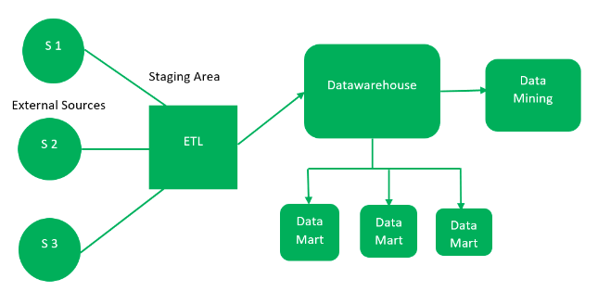
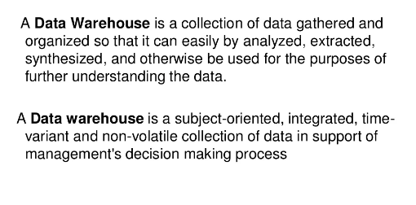
Data Warehouse Concepts

Slide 3
The Architecture
A typical data warehouse consists of
Source
Staging Area
Data warehouse/Data Mart
End user

Slide 4
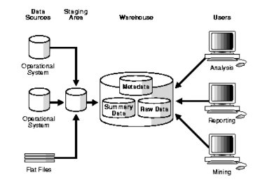
Data Warehouse Architecture (With a Staging Area)

Slide 5
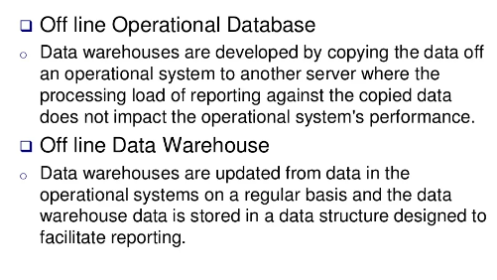
General Stages of Data Warehouse

Slide 6
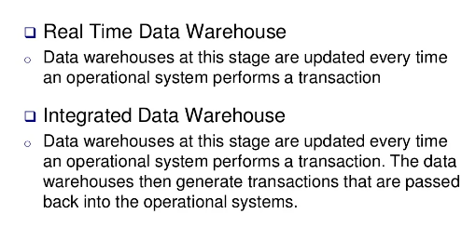
General Stages of Data Warehouse

Slide 7
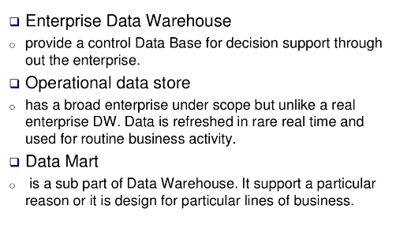
Types of Data Warehouse

Slide 8
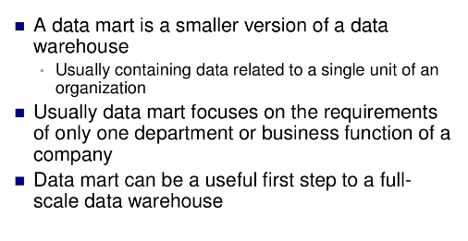
Data Mart

Slide 9
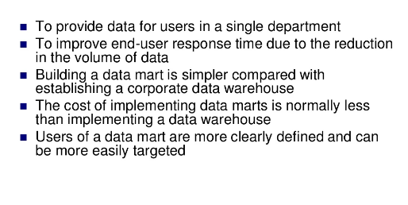
Reasons for Creating Data Mart

Slide 10
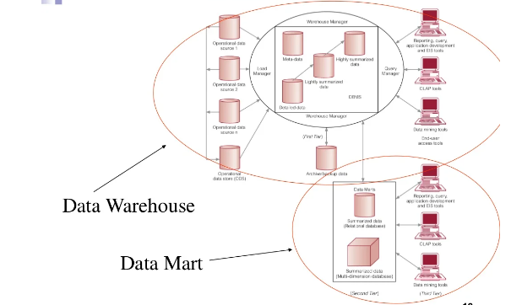
Data Warehouse & Data Mart

Slide 11
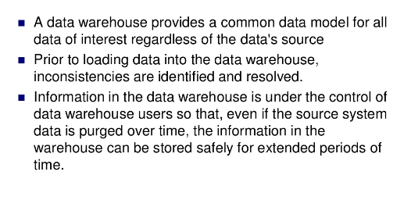
Benefits of Data Warehousing

Slide 12
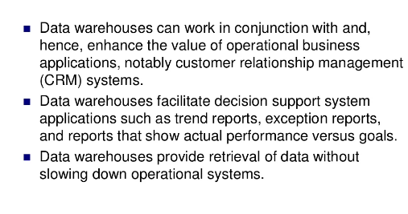
Benefits of Data Warehousing … contd

Slide 13
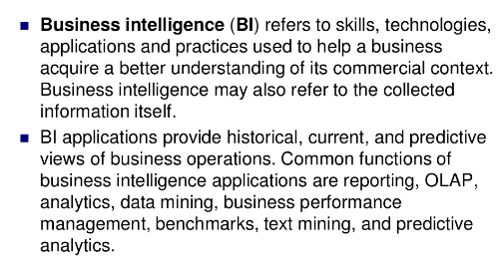
Business Intelligence

Slide 14
Types of BI Tools
Spreadsheets
Reporting and Querying tools
OLAP
Digital Dashboards
Data Mining
Process mining
Business performance management

Slide 15
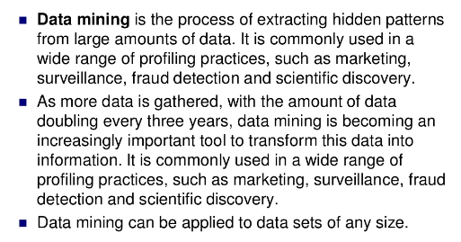
Data Mining

Slide 16
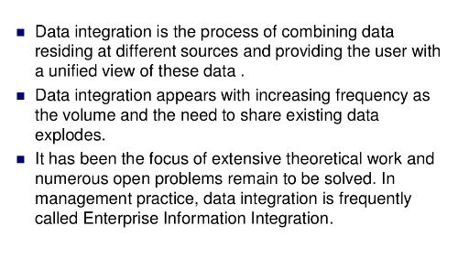
Data integration

Slide 17
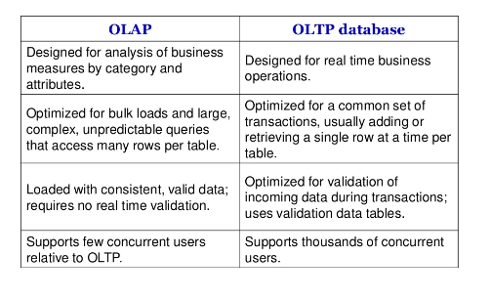
OLAP & OLTP

Slide 18
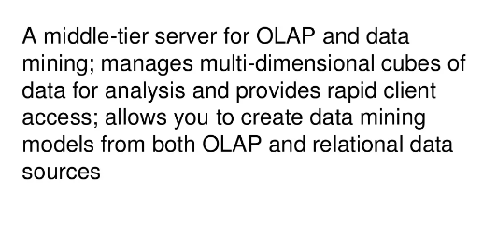
Analysis Services

Slide 19
Data Warehousing Schemas
Star Schemas
Snowflake Schemas

Slide 20
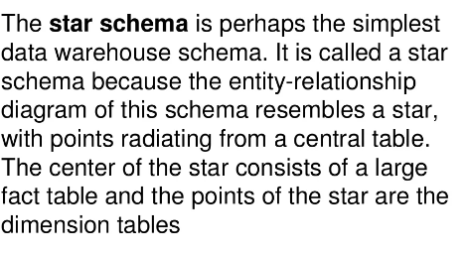
Star Schema

Slide 21
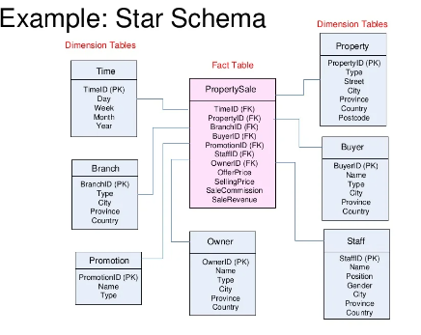
Example of Star Schema

Slide 22
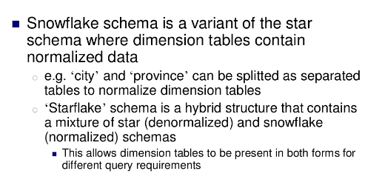
Snowflake Schema

Slide 23
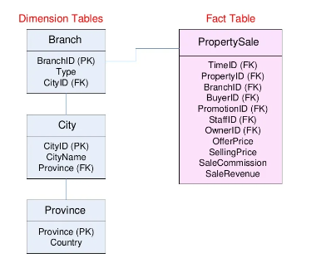
Example : Snowflake Schema

Slide 24
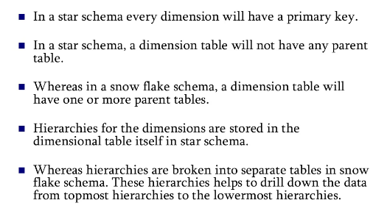
Best Practices of Star and Snowflake Schema

Slide 25
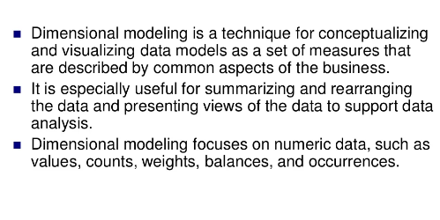
Dimension Modeling

Slide 26
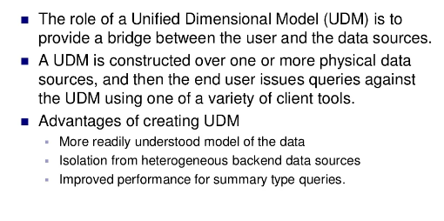
Unified Dimensional Data Model (UDM)

Slide 27
Basic Concepts
Dimensional modelling has several basic concepts:
Facts
Dimensions
Measures (variables)

Slide 28
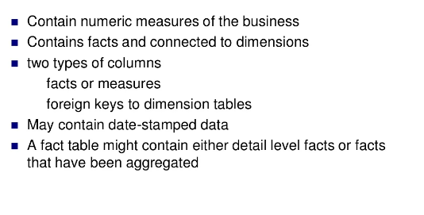
Fact Table

Slide 29
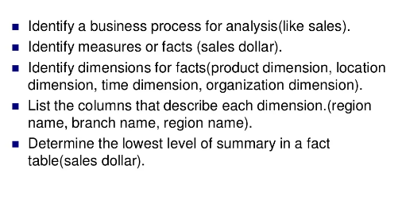
Steps in designing Fact Table

Slide 30
Types of Facts (Measures)
Additive – Measures that can be added across all dimensions.
Semi Additive – Measures that can be added across dimensions and not with others.
Non Additive – Measures that cannot be added across all dimensions

Slide 31
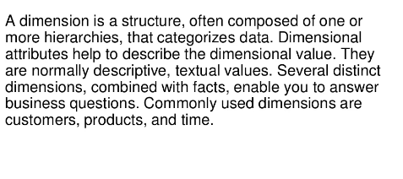
Dimension Tables

Slide 32
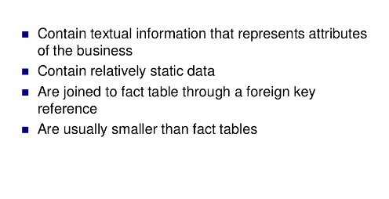
Dimension Tables

Slide 33
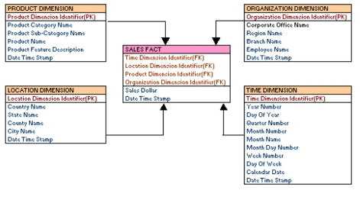
Examples of Dimensions and Facts

Slide 34
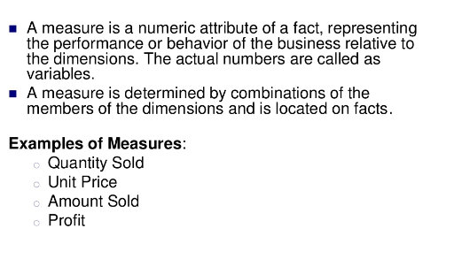
Measures

Slide 35
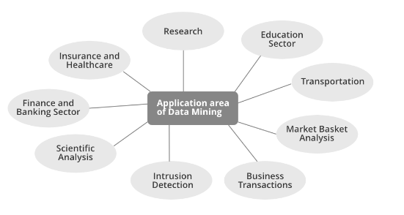
Data Mining Applications

Slide 36
Best Practices of Data Warehouse
Have a data model. ...
Have a data flow diagram. ...
Build a source agnostic integration layer. ...
Adopt a recognized data warehouse architecture standard. ...
Consider adopting an agile data warehouse methodology. ...
Favour ELT over ETL.

Slide 37
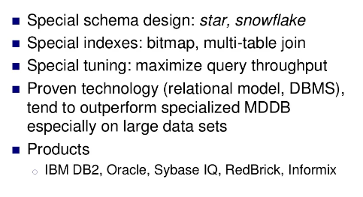
Relational OLAP

Slide 38
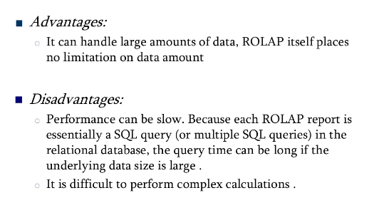
Relational OLAP

Slide 39
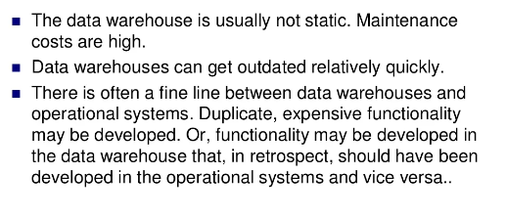
Pitfalls of Data Warehouses

Slide 40
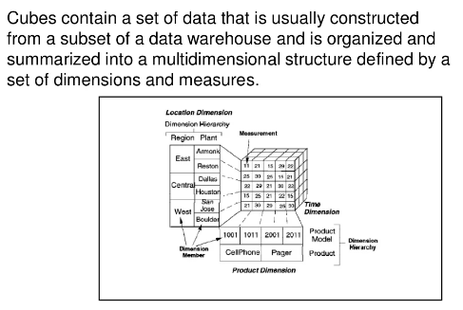
CUBE

Slide 41
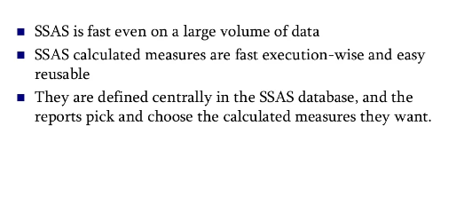
Advantages of SSAS Cubes

